Slide 1




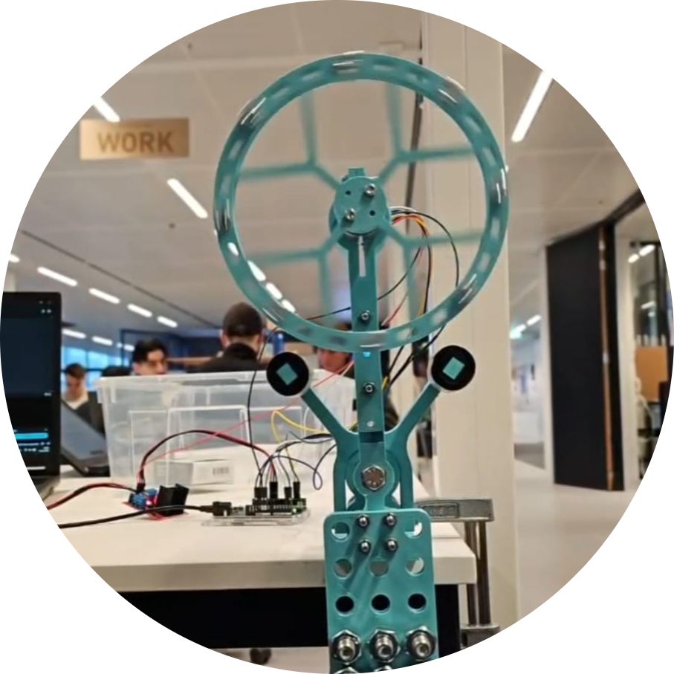
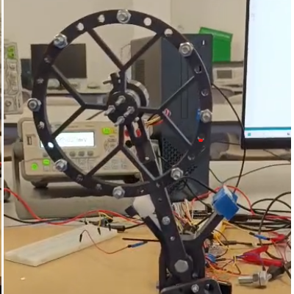
Flywheel Inverted Pendulum (COIL)
Engenharia de Oficinas 3
International Team 4
David Varela
Gabriel Marques
Cisca Wams
Splinter Kohlbrugge
Thijs Ritter
Proffs. Pedro Patrício, Manfred Niehus, Mark Bosman

Slide 2
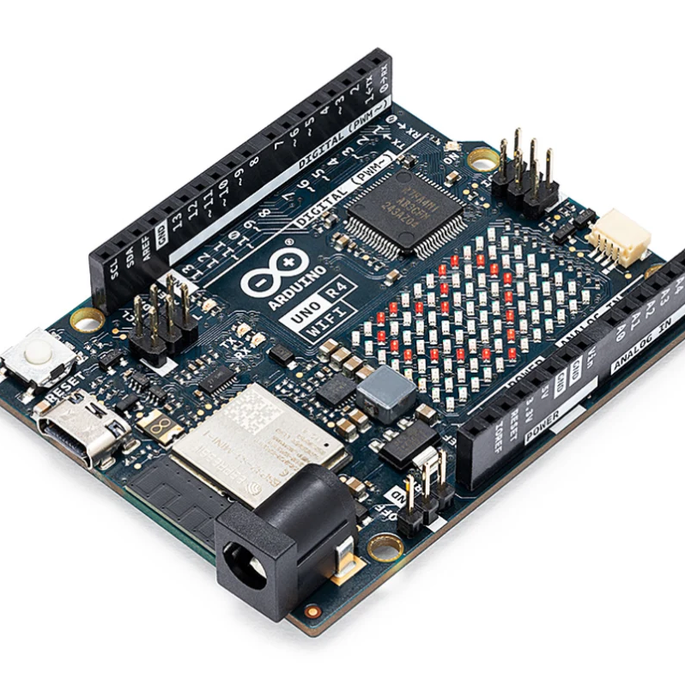
Introduction
Basis of the project
Theoric foundation
Components used and system overview

Slide 3
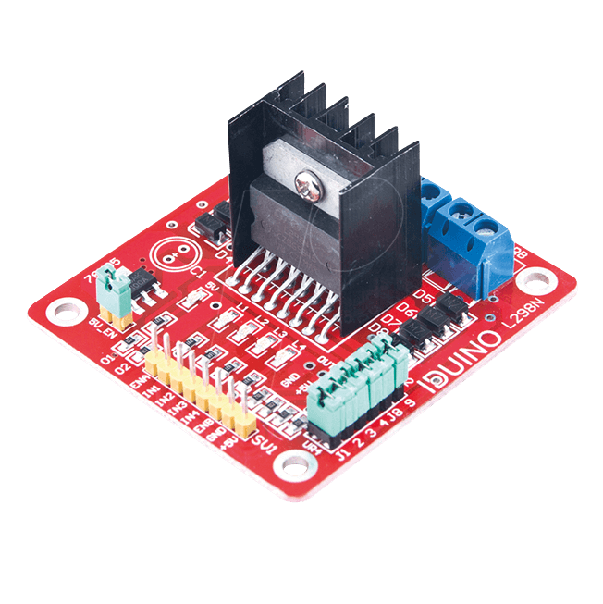

Development
Implementation of code
Troubleshooting
PID control

Slide 4
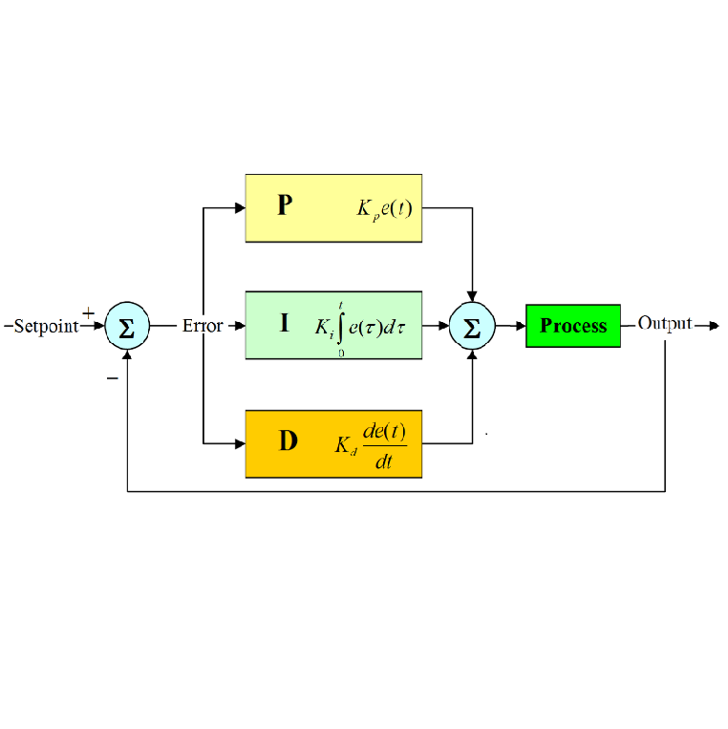
PID Control
P - Proportional
Provides instant correction in relation to the setpoint
I - Integral
Calculates the sum of past errors over time to eliminate steady-state errors
D - Derivative
Predicts future error by assessing the rate of change of the error

Slide 5
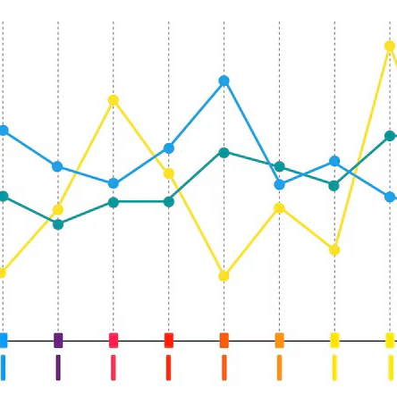
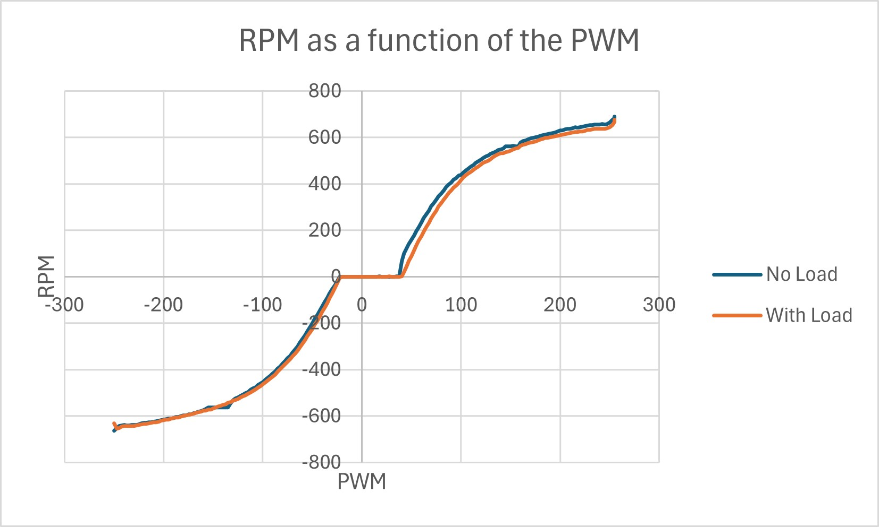
Results
Pendulum results:
Portuguese Team:
1
2
Dutch Team:
1
2

Slide 6
Aditional challenges completed
Starting upside down
Remove some counterweight
Improve the wheel design
Advanced data analysis
Use bearings

